Slide 1
TOPIC- electric CAR RECOMMENDATION USING ML
TEQUED LABS – AI/ML WORKSHOP
Project members:
Anurag Kumar
Kaustubh Pandey
Rio glen lobo
Rishabh Mishra
Shubham kumar
Group Number:2
Team Name: WIRED

Slide 2
What is the project?
We refer to a dataset where there is a driver ID, mean distance and mean speed that a particular driver travels in a day.
Then we divide the drivers into 6 clusters based on the mean distance and mean speed that they have travelled and plot a graph.
Then after implementing the K-Means Clustering algorithm, the user can input the mean distance and mean speed to find out(predict) which cluster they belong to.
The compiler then displays the respective cluster group number and then opens a window which displays the cars that belong to that cluster group such that the user can refer to these and buy a car accordingly.

Slide 3
Understanding why & which algorithm to use
we have to find groups which have not been explicitly labelled in the dataset. Hence this comes under unsupervised learning and to be more precise we shall select k means clustering algorithm.
What is k means clustering?
In simple words, the aim is to segregate groups with similar traits and assign them into clusters.
k-means clustering aims to partition n observations into k clusters in which each observation belongs to the cluster with the nearest mean, serving as a prototype of the cluster.

Slide 4
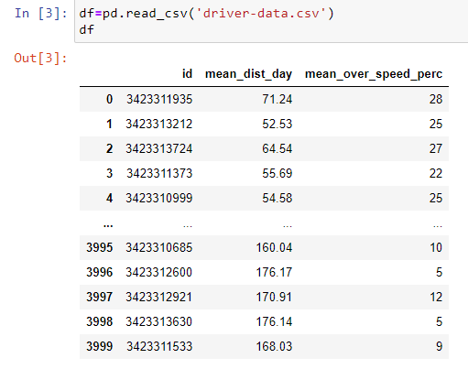
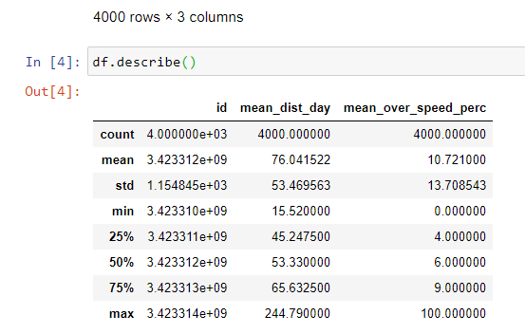
ABOUT THE DATASET

Slide 5
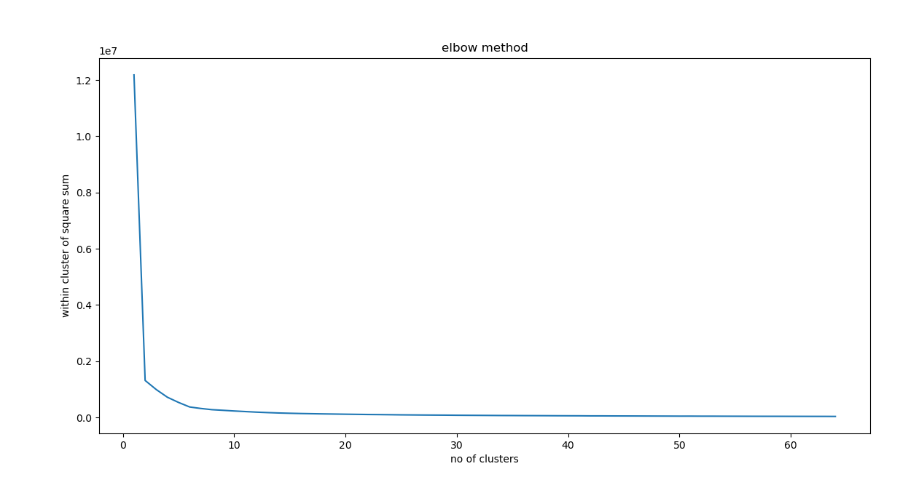
Finding the number of clusters
The first thing we need to do is dividing in the different number of clusters. For this, first we’ll find the value of k. The value of k from our dataset is approx. 64.

Slide 6
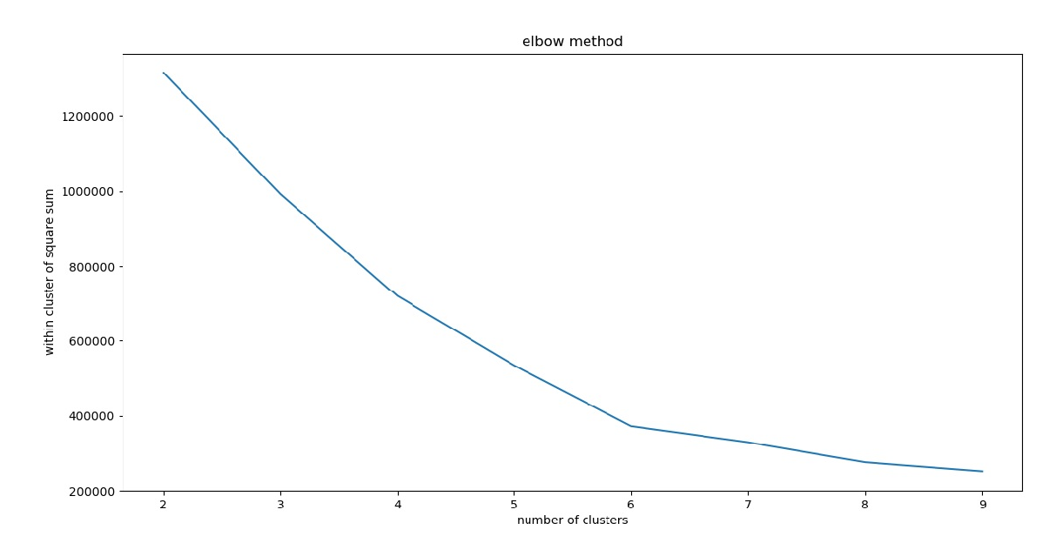
For precision, we shall take help of the elbow method. We find that there are 2 joints in the graph, at position 2 and 6. For more precision we shall take the range 2 to 10. Here we notice that there is a more clear joint at point 6,hence we will take 6 as the number of clusters.

Slide 7
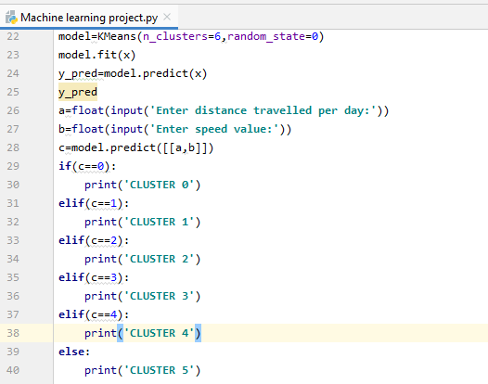
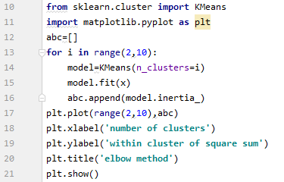
Prediction (how)
Code for elbow method to find the number of clusters.
Code for linking the y_pred to the cluster name

Slide 8
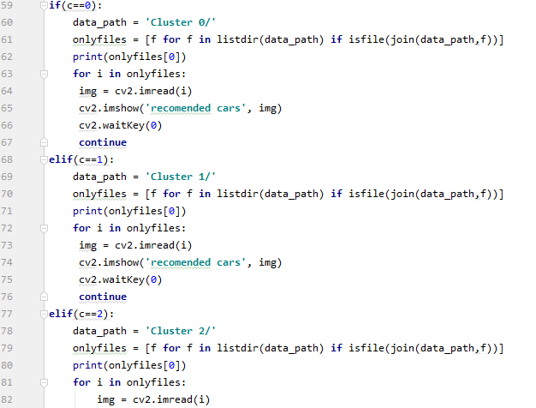
Code for displaying the recommended cars

Slide 9
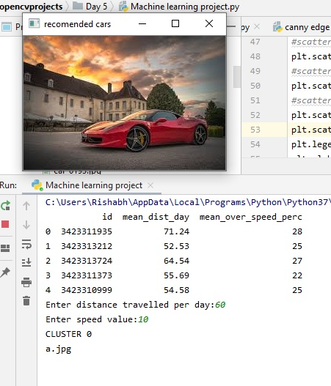
Recommendation (Output)
We see that the user can input the distance travelled and the speed.
That will open a window showing the cluster graph and also tells the respective cluster group.
And finally, it opens another window which displays the recommended car. In this window we can press the enter key to view the other cars that belong to this cluster group so that the user can buy anyone among them.

Slide 10
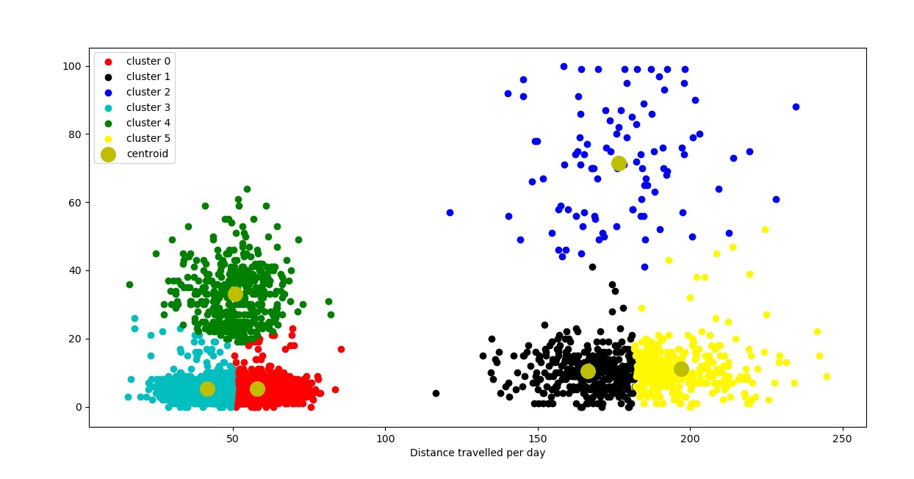
Mean Speed
CLUSTER GRAPH

Slide 11
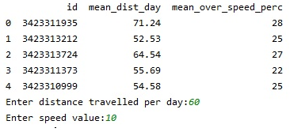
Input for the mean distance and mean speed from the user

Slide 12
CONCLUSION
This machine learning model using k-means clustering method to predict the respective cluster number so that the user can buy an electric car according to the mean distance and mean speed that he/she travels per day to prevent pollution, since electric cars are more eco-friendly!

